Slide 1
Data Structure Analysis and Design

Slide 2
Dynamic Programming

Slide 3
Plan of Lecture
Introduction to Dynamic Programming.
Some simple examples for DP.
All Pair Shortest Path Algorithm.
0-1 Knapsack Problem.

Slide 4
Dynamic Programming
Dynamic Programming is a general algorithm design technique for solving problems defined by or formulated as recurrences with overlapping sub-instances
Invented by American mathematician Richard Bellman in the 1950’s to solve optimization problems and later assimilated by CS
“Programming” here means “planning”

Slide 5
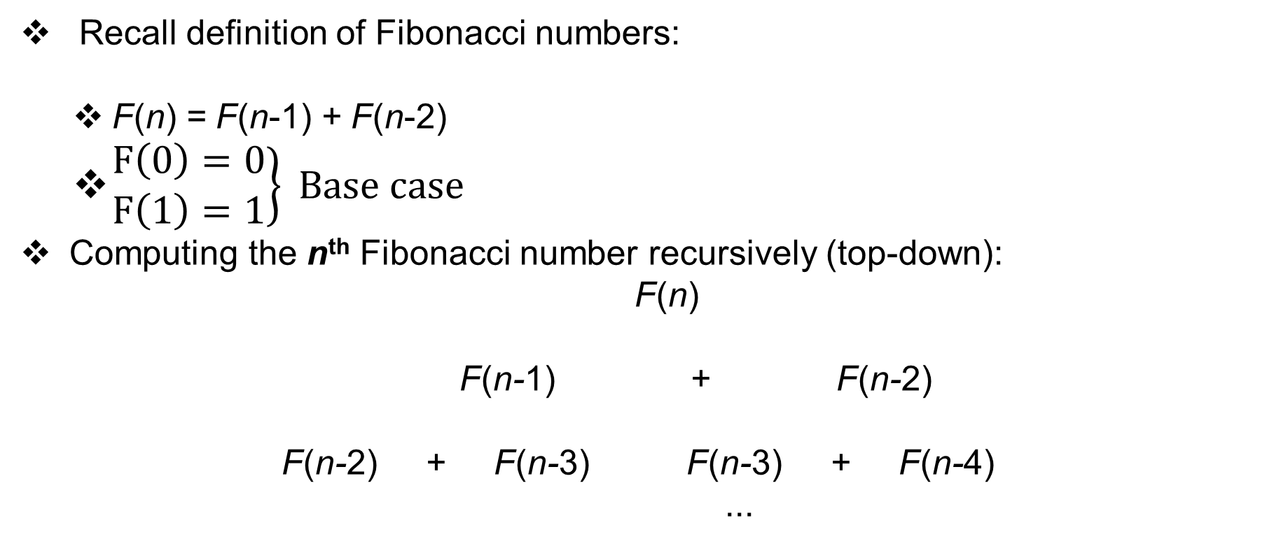
Example: Fibonacci numbers
Recall definition of Fibonacci numbers:
F(n) = F(n-1) + F(n-2)
$\left.\begin{matrix}F\left(0\right)=0 \\ F\left(1\right)=1\end{matrix}\right\} Base case$
Computing the n^{th} Fibonacci number recursively (top-down):
F(n)
F(n-1) + F(n-2)
F(n-2) + F(n-3) F(n-3) + F(n-4)
...

Slide 6
Example: Fibonacci numbers
Draw the Tree of FIB(40) & check for repeated sub problem
Check for the number of sub problems. They also follow Fibonacci sequence.

Slide 7
Example: Fibonacci numbers (cont.)
Computing the n^{th} Fibonacci number using bottom-up iteration and recording results:
F(0) = 0
F(1) = 1
F(2) = 1+0 = 1
…
F(n-2) =
F(n-1) =
F(n) = F(n-1) + F(n-2)
Efficiency:
Time n
Space n

Slide 8
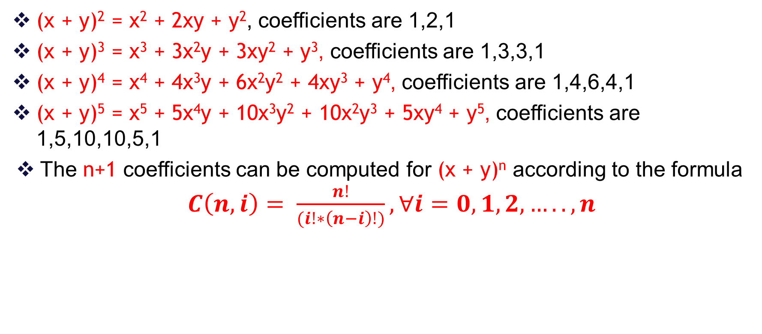
Example 2: Binomial Coefficients
(x + y)² = x² + 2xy + y², coefficients are 1,2,1
(x + y)³ = x³ + 3x²y + 3xy² + y³, coefficients are 1,3,3,1
(x + y)⁴ = x⁴ + 4x³y + 6x²y² + 4xy³ + y⁴, coefficients are 1,4,6,4,1
(x + y)⁵ = x⁵ + 5x⁴y + 10x³y² + 10x²y³ + 5xy⁴ + y⁵, coefficients are 1,5,10,10,5,1
The n+1 coefficients can be computed for (x + y)^{n} according to the formula $C\left(n,i\right)= \frac{n!}{(i!∗\left(n−i\right)!)}, ∀i=0,1,2,….., n$

Slide 9
Example 2: Binomial Coefficients
Check for (x + y)⁷
The repeated computation of all the factorials gets to be expensive.
We can use dynamic programming to save the factorials as we go

Slide 10
Solution by dynamic programming
n c(n,0) c(n,1) c(n,2) c(n,3) c(n,4) c(n,5) c(n,6)
0 1
1 1 1
2 1 2 1
3 1 3 3 1
4 1 4 6 4 1
5 1 5 10 10 5 1
6 1 6 15 20 15 6 1
7 1 7 21 35 35 21 7 1
Each row depends only on the preceding row
Only linear space and quadratic time are needed
This algorithm is known as Pascal’s Triangle

Slide 11
Dynamic Programming
Main idea:
Set up a recurrence relating a solution to a larger instance to solutions of some smaller instances
Solve smaller instances once
Record solutions in a table
Extract solution to the initial instance from that table and create the solution of the bigger problem.

Slide 12
Comparison with Divide-and-Conquer
Divide-and-Conquer algorithms:
split a problem into separate sub-problems,
solve the sub-problems, and
combine the results for a solution to the original problem
Example: Quick sort, Merge sort, Binary Search.
Can be thought of as top-down algorithms
Dynamic Programming algorithm:
Proceeds by solving small problems, then combining them to find the solution to larger problems
Can be thought of as bottom-up

Slide 13
Steps in Dynamic Programming
Characterize structure of an optimal solution.
Define value of optimal solution recursively.
Compute optimal solution values either top-down with caching or bottom-up in a table.
Construct an optimal solution from computed values.
The problem must have the optimal substructure property: “the optimal solution to the problem, contains within it, optimal solutions to smaller subproblems.”
Typically the number of different Overlapping subproblems is polynomial, but the recursive algorithm implementing the recursive formulation of the problem is exponential. This is because of overlapping calls to same subproblem

Slide 14
Example: (knapsack problem)
Example that 0 − 1 knapsack problem cannot be solved greedily:
Note: In fractional knapsack problem we can take 2/3 of ₹ 120 object and get ₹ 240 solution.
0 − 1 knapsack problem can be solved in time O(n * w) using dynamic-programming.

Slide 15
Example: (knapsack problem)
Greedy doesn't work for 0-1 Knapsack Problem:
Example: Knapsack Capacity W = 25 and
Optimal: B and C. Size=10+10=20. Price=9+9=18
Possible greedy approach: take largest Price first (Price=12, not optimal)
Possible greedy approach: take smallest size item first (Price=9+5=14, not optimal)
Item | A | B | C | D
Price | 12 | 9 | 9 | 5
Size | 24 | 10 | 10 | 7

Slide 16

Example: (knapsack problem)
Example: Knapsack Capacity W = 49 and, can pick multiple items from each box.
$C\left(49,3\right)=Max \left\{\begin{aligned}C\left(49,2\right), \# \\ C\left(44,3\right)+14, \end{aligned}\right.$
Knapsack is naturally recursive
$$choose only from the two boxes$$
Item | A | B | C
Price | 5 | 8 | 14
Size | 2 | 3 | 5
$$choose from the third box$$
## of Boxes

Slide 17
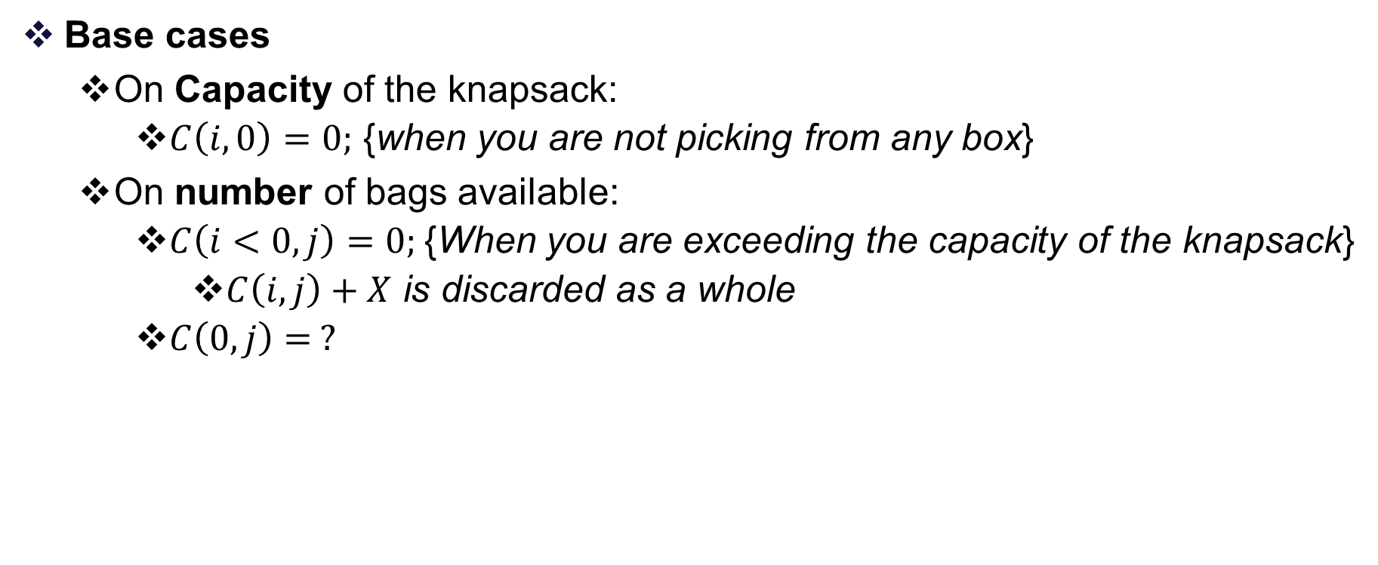
Example: (knapsack problem)
Base cases
On Capacity of the knapsack:
$C\left(i,0\right)=0;$ {when you are not picking from any box}
On number of bags available:
$C\left(i<0,j\right)=0;${When you are exceeding the capacity of the knapsack}
$C\left(i,j\right)+X$ is discarded as a whole
$C\left(0,j\right)= ?$

Slide 18

Example: (knapsack problem)
Example: Knapsack Capacity W = 49 and, can pick multiple items from each box.
Item | A | B | C
Price | 5 | 8 | 14
Size | 2 | 3 | 5
0 | 1 | 2 | 3 | 4 | 5 | 6 | 7 | 8 | 9 | 10 | 11 | 12 | 13 | 14 | 15 | 16 | 17 | 18 | 19 | 20 | 21 | 22 | 23 | 24 | 25 | 26 | 27 | 28 | 29 | 30 | 31 | 32 | 33 | 34 | 35 | 36 | 37 | 38 | 39 | 40 | 41 | 42 | 43 | 44 | 45 | 46 | 47 | 48 | 49
1 | 0 | 5 | 5 | 10 | 10 | 15 | 15 | 20 | 20 | 25 | 25 | 30
2
3

Slide 19
Example: (knapsack problem)
Example: Knapsack Capacity W = 49 and, can pick multiple items from each box.
Item | A | B | C
Price | 5 | 8 | 14
Size | 2 | 3 | 5
0 | 1 | 2 | 3 | 4 | 5 | 6 | 7 | 8 | 9 | 10 | 11 | 12 | 13 | 14 | 15 | 16 | 17 | 18 | 19 | 20
1 (5) | 0 | 5 | 5 | 10 | 10 | 15 | 15 | 20 | 20 | 25 | 25 | 30 | … | … | …. | …. | … | …. | …. | …
2 (8) | 0 | 5 | 8 | 10 | 13 | 16 | 18 | 21 | 24 | 26 | 29 | 32 | ….. | …. | …. | ….. | ….. | ….. | ….. | …
3 (14) | 0 | 5 | 8 | 10 | 14 | 16 | 22 | 22 | 24 | 28 | 30 | 36 | ….. | ….. | …… | ….. | ….. | ….. | ….. | …..

Slide 20
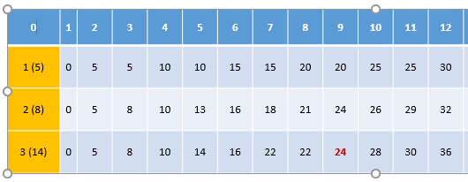

Slide 24
All Pair Shortest Path Algorithm.
Shortest Path Algorithms
Single source single destination.
Topological sort (DFS with Time Stamp)
Single source all destinations.
Dijkstra's Algorithm
All pairs (every vertex is a source and destination).
Floyd - Warshall algorithm

Slide 25
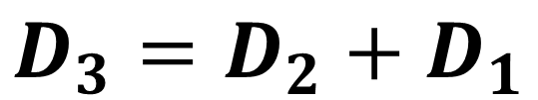

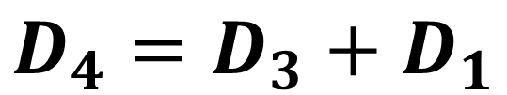
All Pair Shortest Path Algorithm.
D(x, y, k) = Shortest Path from x to y that uses atmost k edges in between, with k<=n-1
$$D\left(x,y,k\right)=\min{∀ m}\left\{D\left(x,m,k−1\right)+weight (m,y)\right\}$$
D(x,y) = W(x,y)
For K = 2 to n-1;
for x=1 to n
for y=1 to n
D’ (x,y) = D(x,m)+W(x,y)
end For
end For
(Ɐ (x,y), D(x,y) = D’(x,y)
End For
B
D₁ | A | B | C | D | E
A | 0 | 3 | 8 | ∞ | -4
B | ∞ | 0 | ∞ | 1 | 7
C | ∞ | 4 | 0 | ∞ | ∞
D | 2 | ∞ | -5 | 0 | ∞
E | ∞ | ∞ | ∞ | 6 | 0
D₂ | A | B | C | D | E
A | 0 | 3 | 8 | 2 | -4
B | 3 | 0 | -4 | 1 | 7
C | ∞ | 4 | 0 | 5 | 11
D | 2 | -1 | -5 | 0 | -2
E | 8 | ∞ | 1 | 6 | 0
3
4
A
8
C
7
1
-5
-4
2
E
6
D
$$D_{3}=D_{2}+D_{1}$$
$$D_{4}=D_{3}+D_{1}$$

Slide 26


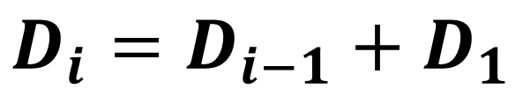
All Pair Shortest Path Algorithm.
D(x, y, k) = Shortest Path from x to y that uses atmost k edges in between, with k<=n-1
$$D\left(x,y,k\right)=\min{∀ m}\left\{D\left(x,m,k−1\right)+weight (m,y)\right\}$$
B
D₁ | A | B | C | D | E
A | 0 | 3 | 8 | ∞ | -4
B | ∞ | 0 | ∞ | 1 | 7
C | ∞ | 4 | 0 | ∞ | ∞
D | 2 | ∞ | -5 | 0 | ∞
E | ∞ | ∞ | ∞ | 6 | 0
D₂ | A | B | C | D | E
A | 0 | 3 | 8 | 2 | -4
B | 3 | 0 | -4 | 1 | 7
C | ∞ | 4 | 0 | 5 | 11
D | 2 | -1 | -5 | 0 | -2
E | 8 | ∞ | 1 | 6 | 0
D₃ | A | B | C | D | E
A
B
C | 7
D
E
3
4
A
8
C
7
1
-4
2
-5
E
6
D
$$D_{3}=D_{2}+D_{1}$$
$$D_{4}=D_{3}+D_{1}$$
$$D_{i}=D_{i−1}+D_{1}$$

Slide 27
All Pair Shortest Path Algorithm.
D(x, y, k) = Shortest Path from x to y that uses atmost k edges in between, with k<=n-1
$$D\left(x,y,k\right)=\min{∀ m}\left\{D\left(x,m,k−1\right)+weight (m,y)\right\}$$
B
D₁ | A | B | C | D | E
A | 0 | 3 | 8 | ∞ | -4
B | ∞ | 0 | ∞ | 1 | 7
C | ∞ | 4 | 0 | ∞ | ∞
D | 2 | ∞ | -5 | 0 | ∞
E | ∞ | ∞ | ∞ | 6 | 0
D₂ | A | B | C | D | E
A | 0 | 3 | 8 | 2 | -4
B | 3 | 0 | -4 | 1 | 7
C | ∞ | 4 | 0 | 5 | 11
D | 2 | -1 | -5 | 0 | -2
E | 8 | ∞ | 1 | 6 | 0
D₃ | A | B | C | D | E
A | 0 | 3 | -3 | 2 | -4
B | 3 | 0 | -4 | 1 | -1
C | 7 | 4 | 0 | 5 | 11
D | 2 | -1 | -5 | 0 | -2
E | 8 | 5 | 1 | 6 | 0
3
4
A
8
C
7
1
-4
2
-5
E
6
D
$$D_{3}=D_{2}+D_{1}$$
$$D_{4}=D_{3}+D_{1}$$
$$D_{i}=D_{i−1}+D_{1}$$

Slide 28

All Pair Shortest Path Algorithm.
D(x, y, k) = Shortest Path from x to y that uses atmost k edges in between, with k<=n-1
$$D\left(x,y,k\right)=\min{∀ m}\left\{D\left(x,m,k−1\right)+weight (m,y)\right\}$$
B
D₁ | A | B | C | D | E
A | 0 | 3 | 8 | ∞ | -4
B | ∞ | 0 | ∞ | 1 | 7
C | ∞ | 4 | 0 | ∞ | ∞
D | 2 | ∞ | -5 | 0 | ∞
E | ∞ | ∞ | ∞ | 6 | 0
D₃ | A | B | C | D | E
A | 0 | 3 | -3 | 2 | -4
B | 3 | 0 | -4 | 1 | -1
C | 7 | 4 | 0 | 5 | 11
D | 2 | -1 | -5 | 0 | -2
E | 8 | 5 | 1 | 6 | 0
D₄ | A | B | C | D | E
A | 0 | 1 | -3 | 2 | -4
B | 3 | 0 | -4 | 1 | -1
C | 7 | 4 | 0 | 5 | 3
D | 2 | -1 | -5 | 0 | -2
E | 8 | 5 | 1 | 6 | 0
3
4
A
8
C
7
1
-4
2
-5
E
6
D
$$D_{4}=D_{3}+D_{1}$$

Slide 29


All Pair Shortest Path Algorithm.
D(x, y, k) = Shortest Path from x to y that uses atmost k edges in between, with k<=n-1
$$D\left(x,y,k\right)=\min{∀ m}\left\{D\left(x,m,k−1\right)+weight (m,y)\right\}$$
Should we compute D₅?
B
D₁ | A | B | C | D | E
A | 0 | 3 | 8 | ∞ | -4
B | ∞ | 0 | ∞ | 1 | 7
C | ∞ | 4 | 0 | ∞ | ∞
D | 2 | ∞ | -5 | 0 | ∞
E | ∞ | ∞ | ∞ | 6 | 0
D₄ | A | B | C | D | E
A | 0 | 1 | -3 | 2 | -4
B | 3 | 0 | -4 | 1 | -1
C | 7 | 4 | 0 | 5 | 3
D | 2 | -1 | -5 | 0 | -2
E | 8 | 5 | 1 | 6 | 0
D₅ | A | B | C | D | E
A | 0 | 1 | -3 | 2 | -4
B | 3 | 0 | -4 | 1 | -1
C | 7 | 4 | 0 | 5 | 3
D | 2 | -1 | -5 | 0 | -2
E | 8 | 5 | 1 | 6 | 0
3
4
A
8
C
7
1
-4
2
-5
E
6
D
$$D_{5}=D_{4}+D_{1}$$

Slide 30

Floyd - Warshall algorithm
D(x, y, k) = Shortest Path from x to y that uses atmost k edges in between, with k<=n-1
$$D\left(x,y,k\right)=\min{∀ m}\left\{D\left(x,y\right),D\left(x,m\right)+D(m,y)\right\}$$

Slide 31
Comments
Dynamic programming relies on working “from the bottom up” and saving the results of solving simpler problems
These solutions to simpler problems are then used to compute the solution to more complex problems
Dynamic programming solutions can often be quite complex and tricky
Dynamic programming is used for optimization problems, especially ones that would otherwise take exponential time
Only problems that satisfy the principle of optimality are suitable for dynamic programming solutions
Since exponential time is unacceptable for all but the smallest problems, dynamic programming is sometimes essential

Slide 32
Comparison of greedy technique with dynamic programming
Both techniques use optimal substructure (“optimal solution contains optimal solution for subproblems within it”).
In dynamic programming, solution depends on solution to subproblems. i.e., compute the optimal solutions for each possible choice and then compute the optimal way to combine things together.
Any problem that can be solved by a greedy algorithm can be solved by dynamic programming, but not the other way around.
In greedy algorithm we choose what looks like best solution at any given moment and recurse (choice does not depend on solution to subproblems).
Note: Short sightedness: Always go for seemingly next best thing, optimizing the present without regard for the future, and never change past choices.

Slide 33
Comparison of greedy technique with dynamic programming
It is often hard to figure out when being greedy works!
How do we know if being greedy works? Try dynamic programming first and understand the choices. Try to find out if there is a locally best choice, i.e. a choice that looks better than the others (without computing recursive solutions to subproblems). Now try to prove that it works correctly.
Greedy correctness proof: It is enough to prove that there exists an optimal solution which contains the greedy choice. i.e., prove that, having made the greedy choice, what remains is a subproblem with the property that if we combine the optimal solution to the subproblem with the greedy choice, we get an optimal solution for the original problem. Typically this is proved by contradiction.

Slide 34
NP Complete Problem

Slide 35
NP Complete Problems
P Problems
NP Problems
NP Complete Problems (NPC Problems)
(Guess the solution & check, if it is the solution)
SAT Problem
Reduction
SAT to 3SAT

Slide 37
Thank You

